Slide 1
Software Design for Cloud 2
Python Programming
Lecture 8
Exception Handling

Slide 2
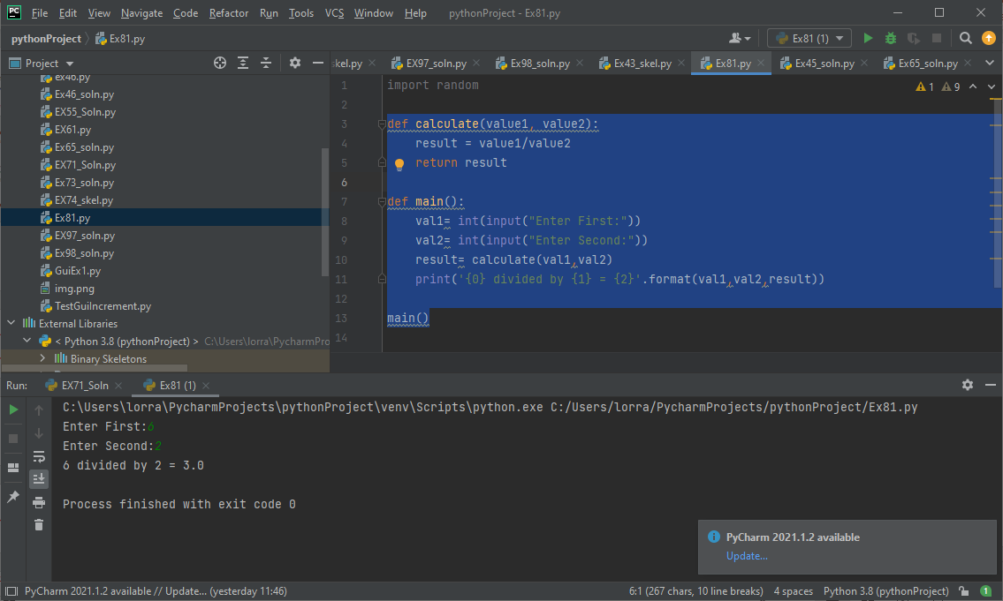
No Error Handling
def calculate(value1, value2):
result = value1/value2
return result
def main():
val1= int(input("Enter First:"))
val2= int(input("Enter Second:"))
result= calculate(val1,val2)
print('{0} divided by {1} = {2}'.format(val1,val2,result))
main()

Slide 3
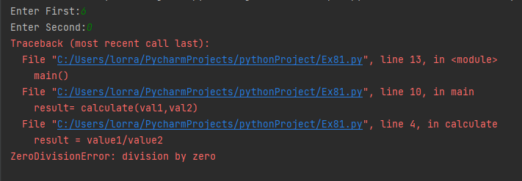
No Error Handling
def calculate(value1, value2):
result = value1/value2
return result
def main():
val1= int(input("Enter First:"))
val2= int(input("Enter Second:"))
:

Slide 4
Traditional Error Handling
def calculate(value1, value2):
if (value2==0):
return 0, True # error
else:
result = value1/value2
return result, False
def main():
val1= int(input("Enter First:"))
val2= int(input("Enter Second:"))
result, error= calculate(val1,val2)
if (error==False):
print('{0} divided by {1} = {2}'.format(val1,val2,result))
else:
print('Cannot Divide by Zero')
main()

Slide 5
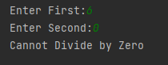
Traditional Error Handling
def calculate(value1, value2):
if (value2==0):
return 0, True # error
else:
result = value1/value2
return result, False
def main():
val1= int(input("Enter First:"))
val2= int(input("Enter Second:"))
result, error= calculate(val1,val2)
if (error==False):
print('{0} divided by {1} = {2}'.format(val1,val2,result))
else:
print('Cannot Divide by Zero')
main()

Slide 6
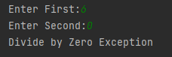
ExceptionHandling
def calculate(value1, value2):
if (value2==0):
raise Exception
else:
result = value1/value2
return result
def main():
val1= int(input("Enter First:"))
val2= int(input("Enter Second:"))
try:
result =calculate(val1,val2)
print('{0} divided by {1} = {2}'.format(val1, val2, result))
except:
print('Divide by Zero Exception')
main()

Slide 7
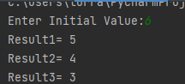
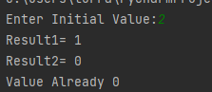
Ex81 raize/catch an exception if value==0
def decrement(value1):
# raise goes here
value1-=1
return value1
def main():
value= int(input("Enter Initial Value:"))
# try goes here
result1 =decrement(value)
print('Result1= {0}'.format(result1))
result2 =decrement(result1)
print('Result2= {0}'.format(result2))
result3 =decrement(result2)
print('Result3= {0}'.format(result3))

Slide 8
ExceptionHandling example2
def calculate(value1, value2):
if (value2==0):
raise ZeroDivisionError
elif (value2<0):
raise ValueError
elif (value2>99):
raise Exception
else:
result = value1/value2
return result

Slide 9
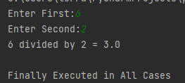
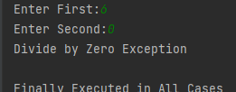


ExceptionHandling example2
def main():
val1= int(input("Enter First:"))
val2= int(input("Enter Second:"))
try:
result =calculate(val1,val2)
print('{0} divided by {1} = {2}'.format(val1, val2, result))
except ZeroDivisionError:
print('Divide by Zero Exception')
except ValueError:
print('Negative value not allowed')
except Exception:
print('Value Too High + All Other Errors')
finally:
print('\nFinally Executed in All Cases')
main()

Slide 10
Some Commonly used built in Exceptions
ValueError - function received a parameter with incorrect value
ZeroDivisionError - attempt made to divided by zero
IndexError - index out of range for list
EOFError - attempt to read beyond end of file
MemoryError - operation runs out of memory
Full list of built-in exceptions at the end of the chapter

Slide 11
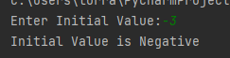
Ex82 raize a ValueError exception in decrement if initial value is negative
def decrement(value1):
# add raise ValueError if value2<0
if (value1==0):
raise Exception
else:
value1-=1
return value1
def main():
value= int(input("Enter Initial Value:"))
try:
:
except Exception: # add ValueError handling
print('Value Already 0')

Slide 12
Exceptions Example3
Now we want to Create our Own Exceptions
class CannotDivideByZero (Exception) : pass
class CannotDivideByNegative (Exception) : pass
Note: pass is a blank statement that does nothing

Slide 13
ExceptionHandling example3
def calculate(value1, value2):
if (value2==0):
raise CannotDivideByZero
elif (value2<0):
raise CannotDivideByNegative
elif (value2>99):
raise Exception
else:
result = value1/value2
return result

Slide 14
ExceptionHandling example3
def main():
val1= int(input("Enter First:"))
val2= int(input("Enter Second:"))
try:
result =calculate(val1,val2)
print('{0} divided by {1} = {2}'.format(val1, val2, result))
except CannotDivideByZero:
print('Divide by Zero Exception')
except CannotDivideByNegative:
print('Negative value not allowed')
except Exception:
print('Value Too High + All Other Errors')
finally:
print('\nFinally Executed in All Cases')
main()

Slide 15
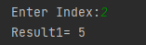
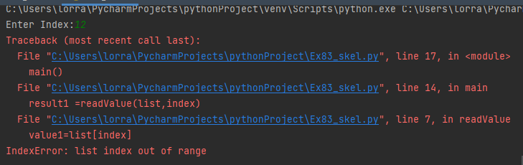
Exercise3 Skel list=[1,4,5,6,4]
def readValue(list, index):
value1=list[index]
return value1
def main():
index= int(input("Enter Index:"))
list=[1,4,5,6,4]
result1 =readValue(list,index)
print('Result1= {0}'.format(result1))
main()
Normal Case
Index Out of Bounds

Slide 16
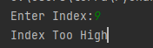

Exercise 3 index= int(input("Enter Index:")) list=[1,4,5,6,4]
Normal Case
IndexTooHigh Exception
IndexTooLow Exception

Slide 17
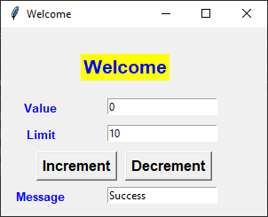

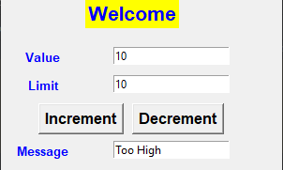
Ex4 change increment to rasise TooHigh Exception
class TooLow (Exception) : pass
class Counter:
:
def decrement(self):
if (self.value>0):
self.value -= 1
else:
raise TooLow
def increment(self): # Traditional
if (self.value<self.limit):
self.value += 1
return True
else:
return False
Need decrement to raise
TooHigh exception

Slide 18
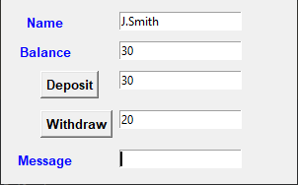
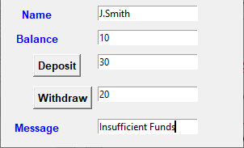
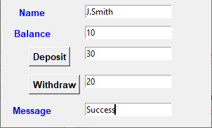
Ex5 Class Account raise it if you attempt to withdraw too much
3 Steps
Define class InsuffFunds
Modily function withdraw
to raise InsuffFunds (if
try to withdraw too much)
Modify withdrawEvent
method to add try, exception

Slide 19
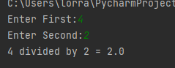
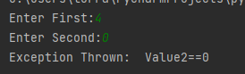
Exception with parameters
def calculate(value1, value2):
if (value2==0):
raise Exception("Value2==0“ )
else:
result = value1/value2
return result
def main():
val1= int(input("Enter First:"))
val2= int(input("Enter Second:"))
try:
result =calculate(val1,val2)
print('{0} divided by {1} = {2}’.
format(val1, val2, result))
except Exception as Arg:
print('Exception Thrown: ', Arg)
main()

Slide 20
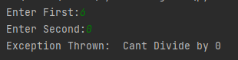
Custom Exception Class with parameters
class NoZeroDiv(Exception) : pass
def calculate(value1, value2):
if (value2==0):
raise NoZeroDiv("Cannot Divide by 0")
else:
result = value1/value2
return result

Slide 21
Custom Exception Class with parameters
def main():
val1= int(input("Enter First:"))
val2= int(input("Enter Second:"))
try:
result =calculate(val1,val2)
print('{0} divided by {1} = {2}'.format(val1, val2, result))
except NoZeroDiv as Arg2:
print('Exception Thrown: ', Arg2)
main()

